Slide 1
“What is the relationship between store trading duration and revenue?”
Schema
Entity Relationship Diagram
exploration

Slide 2
The solution
“what is the relationship between the length of time a shop has been in business, and the sales adventure works makes to that shop”
[AdventureWorks2019].[Sales].[vStoreWithDemographics]
A one stop shop

Slide 3
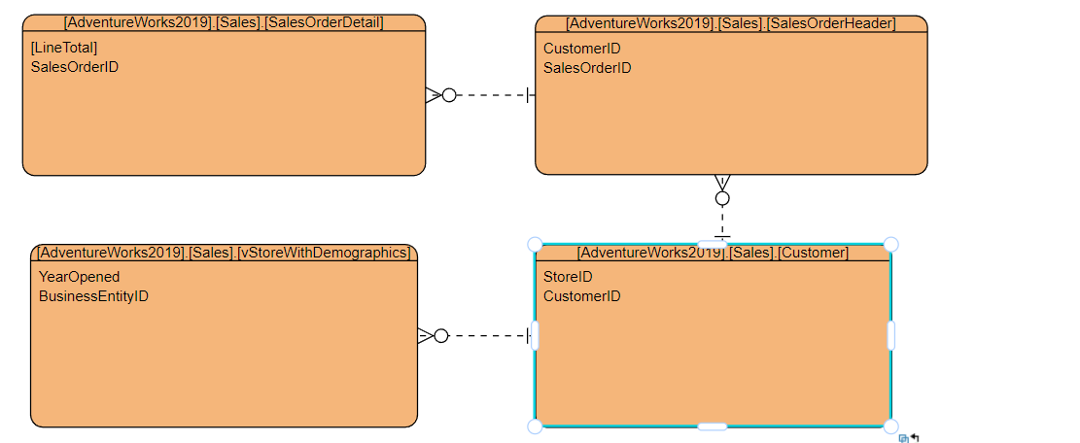
A change of direction
“not recommended”, whatever that means, to use the revenue figure from.
[AdventureWorks2019].[Sales].[vStoreWithDemographics]

Slide 4
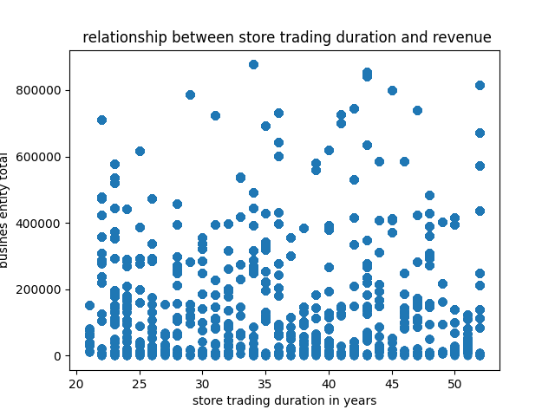
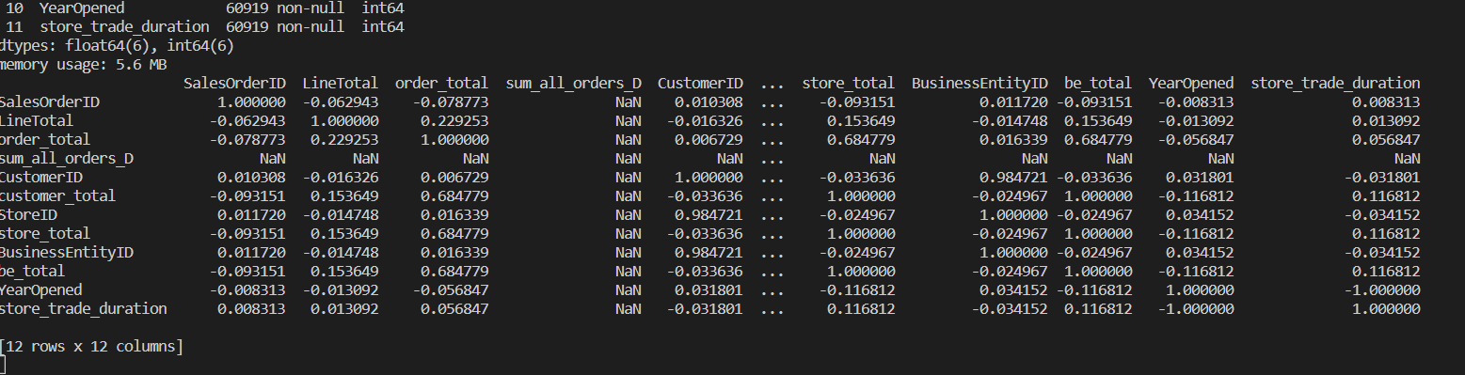
conclusion

